Slide 1
Android Fragments
CMP SCI 4020/5020
Spring 2019

Slide 2

What are fragments
Fragments have two roles really:
One is for UI
One is for controlling behavior or data
Originally introduced as a way to make the UI more flexible and dynamic
This is probably why Fragments tie directly to an Activity
An Activity can contain MANY fragments
Introduced in API level 11 (Honeycomb)

Slide 3
Fragments for UI
Lets look at Fragments as UI components first
This would “replace” a Layout within the XML
This allows you to break apart your Activity’s UI screen into pieces or “fragments”
All fragments have their OWN lifecycle events
These events match what the activity has

Slide 4
Fragments
Fragments must ALWAYS be embedded into an activity
The Fragment lifecycle is directly affected by the Activity lifecycle
Fragments can be a part of the “C” in MVC
Fragments can have a View and as such it acts as a controller

Slide 5
Fragment ui
When fragments are added as UI components, it belongs to a ViewGroup that the Activity holds
Fragments should be designed to be Reused (But may not always be possible or “good”)
This is where MVC really shines
Fragments also help in designing the interface for Tablet and phone without redesigning the layout
Because fragments are contained within an activity, you can use the activity as the communication between them

Slide 6
Fragment lifecycle
Has similar methods as an Activity (create, start, resume, pause, stop, destroy)
But also has some new ones:
onAttach()
onCreateView()
onActivityCreated()
onDestroyView()
onDetach()

Slide 7
fragment lifecycle

Slide 8
Fragment Ui layout
Layouts are created in onCreateView() instead
Properties of this method are:
LayoutInflater, ViewGroup, Bundle
You then “inflate” the view:
inflater.inflate(R. Resource, ViewGroup, Boolean attach)
The boolean is to tell it to attach to the current ViewGroup (usually false for this)
But………there is an easy way too

Slide 9
fragment ui layout
You can also add it to the XML!
<fragment (yes it is lowercase)
class=“edu.umsl.appname.FragmentClassName”
tools:layout=“@layout/fragment_layout” - This tells the preview to draw this layout inside of the fragment
… />
This ties the Fragment directly to the activity
Fragments setup this way cannot be swapped out

Slide 10
Managing fragments
Fragment Manager has everything you need
To GET fragments you can use:
getFragmentById() - use for UI Fragments
getFragmentByTag() - for Non-UI Fragments
popBackStack() - Performs a “Back Button” action
FragmentTransaction takes care of the rest (which is part of FragmentManager)

Slide 11
add to activity
Activities have a FragmentManager and a FragmentTransaction
val fragment = FragmentSubclass()
val manger = supportFragmentManager
val trans = manager.beginTransaction()
trans.add(R. ResourceID, Fragment); OR trans.replace(R. ResourceID, Fragment);
trans.addToBackStack(null OR String IDENTIFIER)
trans.commit();

Slide 12
Fragment workers
When a Fragment is created but not attached to the UI it becomes a “Worker”
You would add a fragment using the same methods with one difference: trans.add(Fragment, String TAG)
No need to add a non-UI Fragment to BackStack

Slide 13
communicating to
parent activity
So how do you get the fragment talking
to the activity?

Slide 14
how to talk to
parent activity
Create a listener!
What does that look like tho?
What is the Java way to create one?

Slide 15
java interface
Create a public interface in the fragment (like public interface MyFragmentListener)
Add your methods to it that you wish to implement
Have the Activity Implement your “Listener”
Create a variable that references/points to the “Listener”

Slide 16
java interface
In onAttach(Activity activity)
mListener = (MyFragmentListener) activity;
Should probably assign this in a Try/Catch statement
Catch ClassCastException
If you don't remember, catch: Exception e and look at stack trace for actual error

Slide 17
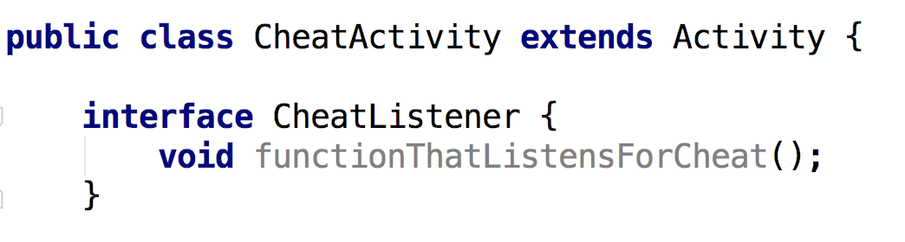
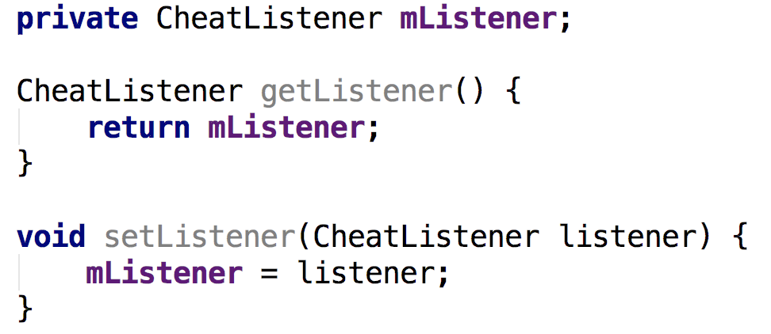
Defining AN
Interface

Slide 18
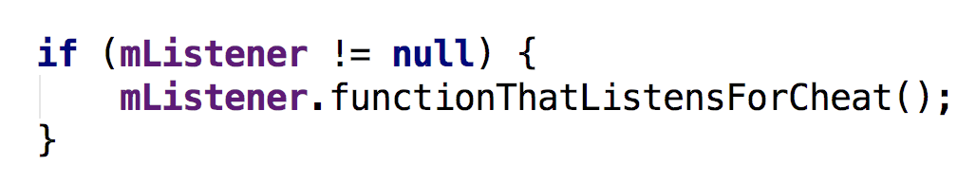
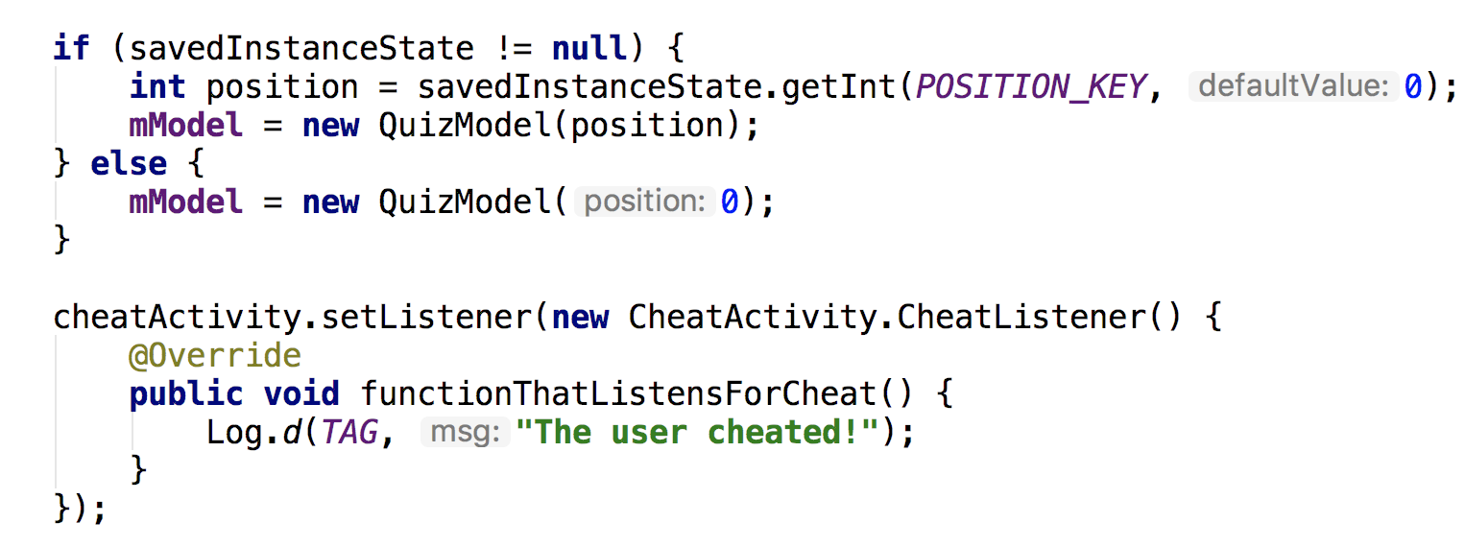
Using an Interface
<— In the class with the
interface defined
In the class that will implement the interface

Slide 19
Not a definitive guide but a good place to start
https://developer.android.com/training/basics/fragments/communicating.html

